Slide 1
Cryptographic Techniques
Substitution Technique
Permutation Technique
Product Cipher

Slide 2
Substitution Techniques
Mono-alphabetic Cipher
----- Caesar Cipher
----- Modified Caesar Cipher
----- General mono-alphabetic Cipher
Polyalphabetic Cipher
Homophonic Substitution Cipher
Polygram Substitution Cipher

Slide 3
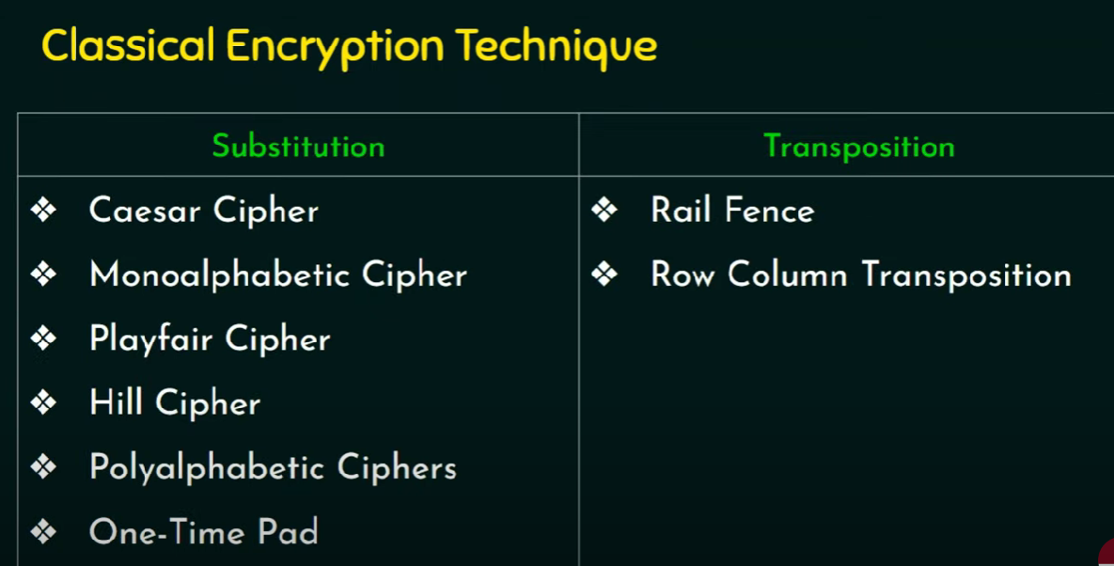

Slide 4
Mono-alphabetic Cipher
The cipher alphabet for each plain alphabet is fixed throughout the encryption process.
If ‘A’ is encrypted as ‘D’, for any number of occurrences in that plaintext, ‘A’ will always get encrypted to ‘D’.

Slide 5
E(x)=(x + k)mod26
where:
E(x) is the encrypted letter,
x is the numerical position of the original letter in the alphabet (e.g., A=0, B=1, ..., Z=25),
k is the shift value (the key)
mod26 is the modulo operation to ensure that the result wraps around the alphabet.

Slide 6
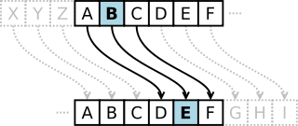
Caesar Cipher

Slide 7
Modified Caesar Cipher
Replace each character by a character which is k position down the order.
Here, the predetermined value of k is the key.
Each character has 25 possibilities of replacement.

Slide 8
General Mono-alphabetic Cipher
No relation exists among the replacement of each alphabets.
For example ----
A → P
B → M
C → A
How many possible keys ???

Slide 9
Since there are 26 letters in the English alphabet, there are 25 possible non-trivial keys for a monoalphabetic Caesar cipher.
This is because a shift of 0 (no shift) and a shift of 26 (a full loop through the alphabet) would result in the same ciphertext as the original plaintext, making these cases trivial. All other shifts, from 1 to 25, are unique and generate distinct ciphertexts for a given plaintext.

Slide 10
Polyalphabetic Cipher
Multiple one-character keys are used. The first key encrypts the first character; the second key encrypts the second character, and so on.
Example -----
Vigenere Cipher

Slide 11
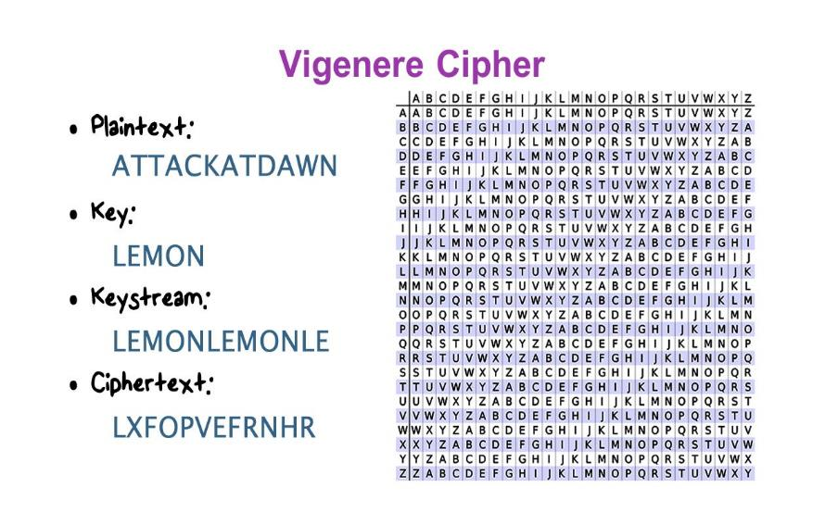
P. T. LETTERS
KEY
LETTERS
Represent {A, B, C, …… Z} by {0, 1, 2, …… 25}
C_{i} =E_{k}(P_{i}) = (P_{i} + K_{i}) mod 26
P_{i} =D_{k}(C_{i}) = (C_{i} - K_{i}) mod 26

Slide 12
Drawback of Vigenere cipher
Key Length Vulnerability: If the key length is shorter than the plaintext, the pattern of the key repeats, leading to potential vulnerabilities. Once the length of the key is determined, the cipher becomes susceptible to frequency analysis, similar to monoalphabetic substitution ciphers.
Weakness to Kasiski Examination: Even though the Vigenère cipher employs multiple Caesar ciphers with different shift values, the repetition of the key means that certain patterns can emerge in the ciphertext, making it susceptible to Kasiski examination, a method for breaking polyalphabetic ciphers.
Cryptanalysis with Known Plaintext: If an attacker has access to a portion of the plaintext and the corresponding ciphertext, they can use this information to deduce parts of the key and potentially decrypt other parts of the message.

Slide 13
Vernam Cipher
Length of binary-key is same as binary-plain text.
c_{i} =e_{k}(p_{i}) = (p_{i} k_{i})
p_{i} =d_{k}(c_{i}) = (c_{i} k_{i})
where c_{i,} p_{i,} k_{i} are the i^{th} binary digits of the cipher text, plain text and key respectively.
represents exclusive-OR operation.
One-time pad is an extended version of Vernam Cipher with random keys (no repetitions).

Slide 14
Homophonic Substitution Cipher
The cipher text character can be any one of the chosen set (i.e., one plain text alphabet can map to more than one cipher text alphabet)
For example -----
X / M / N / O
A
I / Q / S / D
B

Slide 15
Polygram Substitution Cipher
A block of plain text is replaced by a block of cipher text (It does not work on character-by-character basis).
For example -----
HELLO
YEQQW
HELL
TEUI

Slide 16
Next Topic
Transposition Techniques

Slide 17
THANK YOU

